Slide 1

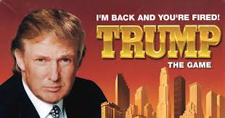
Trump 2.0
“The Future Ain’t What It Used to Be”
GCG Dealmaker’s Meeting
Tokyo, Japan.
November 9, 2024.
Chris Manderson
Ervin Cohen & Jessup LLP
Beverly Hills, California

Slide 2

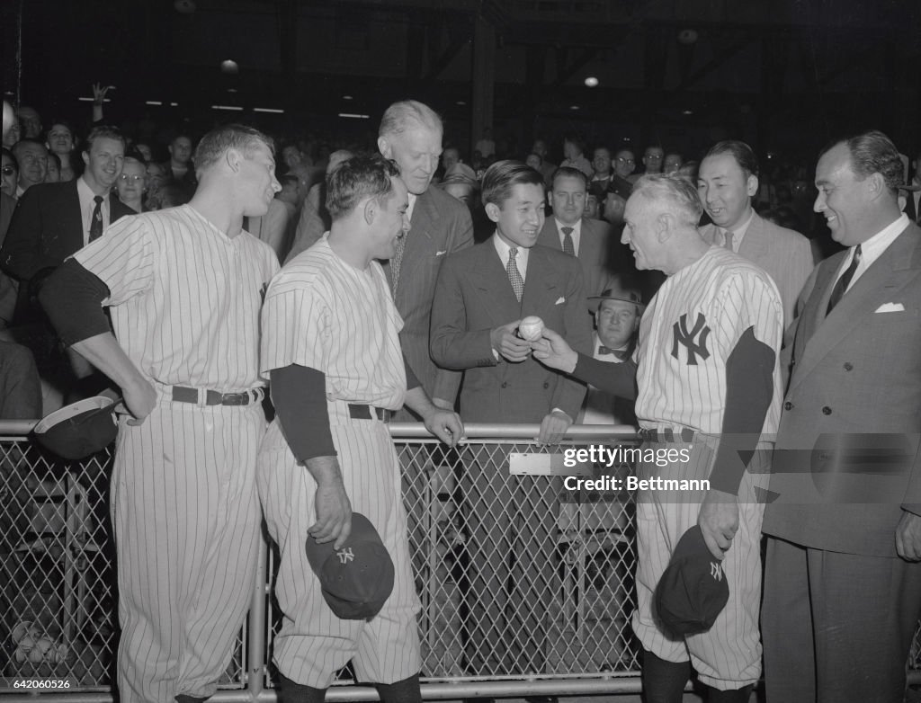
“It’s tough to make predictions… especially about the future” –Yogi Berra

Slide 3
Deal Volume & Value
It’s déjà vu all over again.”
–Yogi Berra
Trump 1.0: 2017-2020
Aggregate Deal Volume: Approximately $6.47 trillion (U.S.)
Average Annual Number of Deals: ~10,250 (U.S.)
Biden 2021-2024
Aggregate Deal Volume: approximately ~$5.46 trillion (through 2023)
  Not adjusted for inflation.
Average Annual Number of Deals: ~10,000 (U.S.)
  2021 M&A boom from pent-up demand from Covid shutdown
  Deal volumes declined from 2022-2024 due to interest rates, regulatory pressure, inflation & uncertainty

Slide 4
What’s Likely to Change
"When you come to a fork in the road, take it.”
Republicans will control the Presidency, & Senate, likely to control House of Representatives
  Executive orders (President) v. Legislation (Congress)
  Administrative agencies (SEC, FTC, Treasury) are part of the Executive Branch
Securities and Exchange Commission (SEC) enforcement priorities
Committee on Foreign Investment in the United States (CIFUS)
Antitrust: FTC, DOJ enforcement activity
Tax Policy & Incentives

Slide 5
Inflation & Interest Rates:
“A nickel ain't worth a dime anymore.”
Federal Reserve rate cut of 0.25% November 8, 2024, follows 0.50% cut in September
  Should increase deal activity by making borrowing cheaper
  Could increase leverage ratios and deal pricing.
Inflation & interest rate hikes depressed deal flow in 2022-2024
Uncertainty: did the Federal Reserve raise rates too high in 2022-2023?
  Will the Fed need to over-correct to stimulate economy?
  Note: the Fed is independent of the administration.

Slide 6
Antitrust Policy and Competition Law
“We made too many wrong mistakes.”
Under Lina Khan, the Biden FTC aggressively scrutinized technology industry acquisitions such as:
  Meta/Facebook (Within Unlimited), Amazon (iRobot-Roomba), and Microsoft (Activision Blizzard), Kroger-Albertsons.
  Regulatory uncertainty and delay has stifled M&A exits
  FTC resisted settlements to facilitate deals
  Caused downstream effects, especially in the technology investment ecosystem, keeping investments illiquid and stifling new investment.
  FTC attempt to invalidate non-compete agreements struck down by courts
Biden’s US Department of Justice is going after Google & Apple:
Suing Google over (i) search, and (ii) advertising monopoly allegations
Suing Apple over monopolizing smartphone markets; App Store
Under Trump 2.0 we can expect:
Potential relaxation of antitrust enforcement in non-tech sectors, easing consolidations.
Emphasis on “market efficiency” over traditional anti-monopoly approaches.

Slide 7
CFIUS (Committee on Foreign Investment in the United States)
“Even Napoleon had his Watergate.”
o Broader definition of “national security” concerns, affecting more industries.
    Cybersecurity & data privacy
    Artificial intelligence
    Supply chains & critical infrastructure (energy, communications)
o Likely focus on limiting Chinese and Russian investments.
o Trump could encourage investment from allied nations through streamlined processes.

Slide 8
Securities & Exchange Commission (SEC) Approach to M&A
“You can observe a lot just by watching.”
o Likely relaxation of disclosure requirements to reduce M&A compliance costs.
o Reduced emphasis on ESG (Environmental, Social, Governance) reporting and cryptocurrency regulation
  Disclosures on climate, financial impacts of ESG, diversity
  Crypto: SEC has alleged that cryptocurrencies are securities, subject to SEC regulation
  Trump 2.0 will likely de-emphasize ESG disclosure and heavy crypto regulation
o More business-friendly leadership appointments expected,
    Prioritizing efficiency and investor protection
    De-emphasizing regulation, rulemaking & social policy issues
o Potential for increased SPAC (Special Purpose Acquisition Company) activity with lighter regulation.
Note: the SEC does not directly regulate M&A. The SEC’s role in M&A is largely focused on disclosure in public filings such as S-4s.

Slide 9
Tax Policy and Incentives for Domestic M&A
“It ain't over till it's over.”
o Some 2017 tax cuts are expiring
  Congress will likely make them permanent, lowering tax burdens for individuals.
  2017 reduction of the corporate tax rate from 35% to 21% is permanent.
    Trump campaigned on reducing taxes to 15% for companies manufacturing in US
  Trump has promised other tax cuts, such as “no tax on tips” and overtime, which could increase capital formation
o Capital gains tax reductions could drive deal-making.
o Potential incentives for depreciation could drive asset deals
and capital investment.

Slide 10
Impact on Environmental, Social, and Governance (ESG) Standards
”I'm not going to buy my kids an encyclopedia. Let them walk to school like I did.”
o Reduced focus on ESG mandates may lower M&A costs in traditional energy, manufacturing.
o Potential rollback of SEC’s ESG-related disclosures, especially in energy and industrial sectors.
o Less regulatory pressure on carbon emissions, making U.S.-based fossil fuel mergers more attractive.
  Could drive energy and supply chain M&A

Slide 11
Sector-Specific Impacts on M&A
“In baseball, you don't know nothing.”
o Energy: Increased opportunities for mergers in fossil fuels due to deregulation.
  Expect greater economic activity around fossil fuels driving M&A
o Technology: continued scrutiny, particularly for large platforms.
o Healthcare: potential for consolidation
o Financial Services: relaxed oversight may encourage more mergers among banks and fintech firms.

Slide 12
Key Challenges and Risks
"If you don't know where you are going, you'll end up someplace else.”
o Inflation and interest rates remain a wild card.
o CFIUS scrutiny could delay or block cross-border deals.
o Policy shifts may create regulatory uncertainty, affecting investor confidence.
o Volatility in tax policy
o Department of Government Efficiency (DOGE):
  Elon, Ron Paul & Vivek have discussed a Government Efficiency Commission
  Would impact staffing levels at SEC, FTC, Treasury and other US government agencies.

Slide 13

What If I’m Wrong?
“I never said most of the things I said.”
- Yogi Berra

Slide 14

Contact
Partner & Chair of the Business, Corporate, and Tax Department
310.281.6374
cmanderson@ecjlaw.com
linkedin.com/in/chris-manderson
Ervin Cohen & Jessup LLP
9401 Wilshire Boulevard, 12th Floor
Beverly Hills, CA 90212

